Slide 1

PHYSICS – Electrical quantities (2)

Slide 2
LEARNING OBJECTIVES
Core •State that the e.m.f. of an electrical source of energy is measured in volts State that the potential difference (p.d.) across a circuit component is measured in volts Use and describe the use of a voltmeter, both analogue and digital State that resistance = p.d. / current and understand qualitatively how changes in p.d. or resistance affect current • Recall and use the equation R = V / I • Describe an experiment to determine resistance using a voltmeter and an ammeter Relate (without calculation) the resistance of a wire to its length and to its diameter Understand that electric circuits transfer energy from the battery or power source to the circuit components then into the surroundings | Supplement Show understanding that e.m.f. is defined in terms of energy supplied by a source in driving charge round a complete circuit Recall that 1 V is equivalent to 1 J / C Sketch and explain the current-voltage characteristic of an ohmic resistor and a filament lamp • Recall and use quantitatively the proportionality between resistance and length, and the inverse proportionality between resistance and cross-sectional area of a wire Recall and use the equations P = IV and E = IVt

Slide 3

Recap
Current is the rate of flow of electrons around a circuit. The higher the current, the faster the electrons are travelling. The unit of current is the amp, and in a circuit an ammeter is used to measure current.
emf

Slide 4
Recap
Current is the rate of flow of electrons around a circuit. The higher the current, the faster the electrons are travelling. The unit of current is the amp, and in a circuit an ammeter is used to measure current.
emf
VOLTAGE is the amount of energy given to electrons as they travel around the circuit.

Slide 5
Recap
Current is the rate of flow of electrons around a circuit. The higher the current, the faster the electrons are travelling. The unit of current is the amp, and in a circuit an ammeter is used to measure current.
emf
VOLTAGE is the amount of energy given to electrons as they travel around the circuit.
Voltage is also known as POTENTIAL DIFERENCE (PD)

Slide 6
Recap
Current is the rate of flow of electrons around a circuit. The higher the current, the faster the electrons are travelling. The unit of current is the amp, and in a circuit an ammeter is used to measure current.
emf
VOLTAGE is the amount of energy given to electrons as they travel around the circuit.
Unit of voltage or PD is the volt.
1 volt = 1 joule of potential energy is given to each coulomb of charge
(1J = 1 J/C)
Supplement
Voltage is also known as POTENTIAL DIFERENCE (PD)

Slide 7
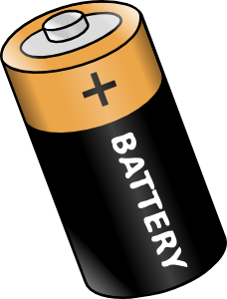
VOLTAGE is the amount of energy given to electrons as they travel around the circuit.
emf
Voltage is also known as POTENTIAL DIFERENCE (PD)
The cell produces its highest potential difference when not connected in a circuit. This maximum PD is known as the electromotive force (EMF) of the cell.
The battery cell gives electrons potential energy. This energy is then passed on to the components in the cell

Slide 8
VOLTAGE is the amount of energy given to electrons as they travel around the circuit.
emf
Voltage is also known as POTENTIAL DIFERENCE (PD)
The cell produces its highest potential difference when not connected in a circuit. This maximum PD is known as the electromotive force (EMF) of the cell.
The battery cell gives electrons potential energy. This energy is then passed on to the components in the cell
As soon as the cell is connected in a circuit the potential difference drops because of energy wastage inside the cell.

Slide 9


VOLTAGE is the amount of energy given to electrons as they travel around the circuit.
Just a reminder …………
A single cell
A battery, made up of several cells.
Voltage is also known as POTENTIAL DIFERENCE (PD)
A battery is a series of joined cells, although it is commonly used for a single cell as well.
The cell produces its highest potential difference when not connected in a circuit. This maximum PD is known as the electromotive force (EMF) of the cell.
The battery cell gives electrons potential energy. This energy is then passed on to the components in the cell
As soon as the cell is connected in a circuit the potential difference drops because of energy wastage inside the cell.

Slide 10
Measuring voltage (PD) in a circuit.

Slide 11
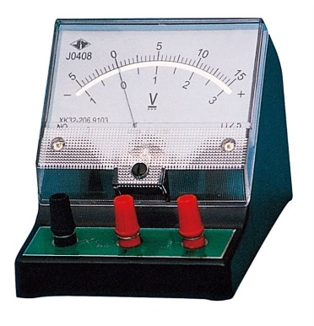

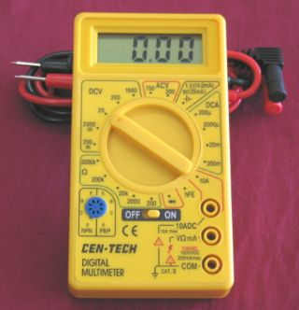
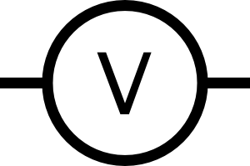
Voltage is measured using a VOLTMETER
Measuring voltage (PD) in a circuit.

Slide 12
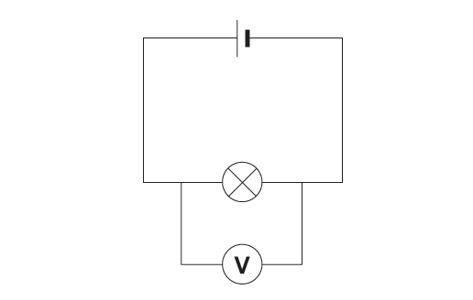
Voltage is measured using a VOLTMETER
Measuring voltage (PD) in a circuit.
To measure the voltage across a component in a circuit the voltmeter must be placed in parallel with it.

Slide 13
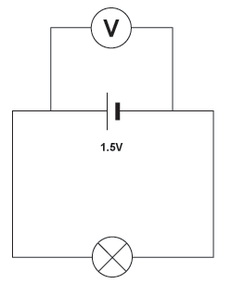
Voltage is measured using a VOLTMETER
Measuring voltage (PD) in a circuit.
To measure the voltage across a component in a circuit the voltmeter must be placed in parallel with it.

Slide 14
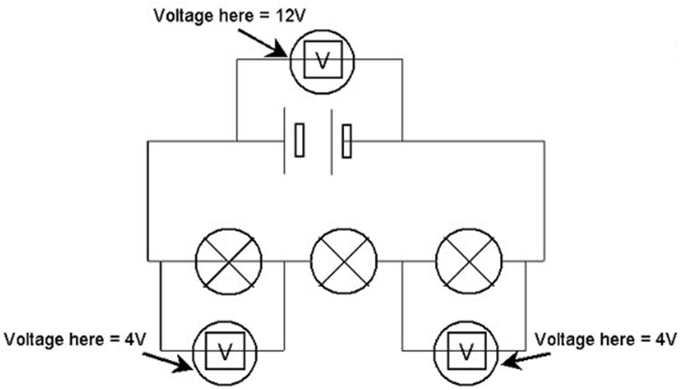
Voltage is measured using a VOLTMETER
Measuring voltage (PD) in a circuit.
Series and parallel circuits
In a series circuit the total voltage (PD) of the supply is shared between the various components, so the voltages around a series circuit always add up to equal the source voltage.

Slide 15
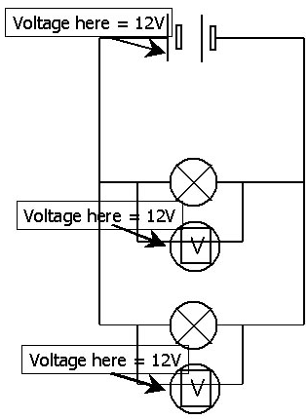
Voltage is measured using a VOLTMETER
Measuring voltage (PD) in a circuit.
Series and parallel circuits
In a parallel circuit all components get the full source voltage, so the voltage is the same across all components
In a series circuit the total voltage (PD) of the supply is shared between the various components, so the voltages around a series circuit always add up to equal the source voltage.

Slide 16

Whenever a current flows around an electrical circuit there is resistance to the electrons.

Slide 17


Whenever a current flows around an electrical circuit there is resistance to the electrons.
Copper connecting wire is a good conductor, it offers little resistance to the electrons, and a current passes through it easily. | Nichrome is not such a good conductor, it has a bigger resistance to the electrons, and less current will flow.

Slide 18
Whenever a current flows around an electrical circuit there is resistance to the electrons.
Copper connecting wire is a good conductor, it offers little resistance to the electrons, and a current passes through it easily. | Nichrome is not such a good conductor, it has a bigger resistance to the electrons, and less current will flow.
Resistance is calculated using this equation:
resistance = voltage R = V
current I
The unit of resistance is the ohm Ω (Greek letter omega)

Slide 19
Whenever a current flows around an electrical circuit there is resistance to the electrons.
Copper connecting wire is a good conductor, it offers little resistance to the electrons, and a current passes through it easily. | Nichrome is not such a good conductor, it has a bigger resistance to the electrons, and less current will flow.
Resistance is calculated using this equation:
resistance = voltage R = V
current I
The unit of resistance is the ohm Ω (Greek letter omega)
eg. If a PD of 8V is needed to make a current of 4A flow through a wire.
Resistance = 8 / 4 = 2Ω

Slide 20
Remember, remember ……….. The equation linking V, I and R
V = I x R
V
I = V / R
I
R
R = V / I

Slide 21
Factors affecting resistance.

Slide 22
Factors affecting resistance
Length of wire
Cross sectional area
Material
Temperature
Factors affecting resistance.

Slide 23
Factors affecting resistance
Length of wire
Cross sectional area
Material
Temperature
Factors affecting resistance.
For metal conductors, resistance increases with temperature. For semi-conductors, it decreases with temperature.

Slide 24
Factors affecting resistance
Length of wire
Cross sectional area
Material
Temperature
Factors affecting resistance.
For metal conductors, resistance increases with temperature. For semi-conductors, it decreases with temperature.
When a current flows through a wire, resistance causes a heating effect. This principle is used in heating elements and in filament light bulbs.

Slide 25



Factors affecting resistance
Length of wire
Cross sectional area
Material
Temperature
Factors affecting resistance.
Electrons collide with atoms as they pass through conductors, losing energy. The atoms vibrate more, causing a heating effect
For metal conductors, resistance increases with temperature. For semi-conductors, it decreases with temperature.
When a current flows through a wire, resistance causes a heating effect. This principle is used in heating elements and in filament light bulbs.

Slide 26
Factors affecting resistance
Length of wire
Cross sectional area
Material
Temperature
Factors affecting resistance.
B
A
Wires A and B have the same cross-sectional area and are at the same temperature. Wire B is twice as long as wire A, and has twice the resistance.

Slide 27

Factors affecting resistance
Length of wire
Cross sectional area
Material
Temperature
Factors affecting resistance.
B
A
Wires A and B have the same cross-sectional area and are at the same temperature. Wire B is twice as long as wire A, and has twice the resistance.
Resistance length
Resistance is directly proportional to length

Slide 28
Factors affecting resistance
Cross sectional area
Material
Temperature
Length of wire
Factors affecting resistance.
A
B
Wires A and B have the same length and are at the same temperature. Wire B is twice the cross-sectional area of A, and has half the resistance.

Slide 29
Factors affecting resistance
Cross sectional area
Material
Temperature
Length of wire
Factors affecting resistance.
A
B
Wires A and B have the same length and are at the same temperature. Wire B is twice the cross-sectional area of A, and has half the resistance.
Resistance 1
area
(area = cross-sectional area)

Slide 30
Factors affecting resistance
Cross sectional area
Material
Temperature
Length of wire
Factors affecting resistance.
Some wires have much more resistance for a given length. For example a 10cm length of nichrome has a much higher resistance than copper of the same length and cross-sectional area. Nichrome is said to have a higher resistivity.

Slide 31
Factors affecting resistance
Cross sectional area
Material
Temperature
Length of wire
Factors affecting resistance.
Some wires have much more resistance for a given length. For example a 10cm length of nichrome has a much higher resistance than copper of the same length and cross-sectional area. Nichrome is said to have a higher resistivity.
Typical resistivity (Ω/m)
Constantan | 49 x 10⁻⁸
Manganin | 44 x 10⁻⁸
Nichrome | 100 x 10⁻⁸
Tungsten | 55 x 10⁻⁸
The Greek letter rho (ρ) is the resistivity constant for any given material)

Slide 32
Factors affecting resistance
Length of wire
Cross sectional area
Material
Temperature
Factors affecting resistance.
Combining the resistance equations

Slide 33

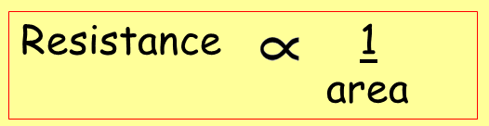
Factors affecting resistance
Length of wire
Cross sectional area
Material
Temperature
Factors affecting resistance.
Combining the resistance equations
Resistance length
area

Slide 34
Factors affecting resistance
Length of wire
Cross sectional area
Material
Temperature
Factors affecting resistance.
Combining the resistance equations
R = ρ x l
A
Resistance length
area

Slide 35
Factors affecting resistance
Length of wire
Cross sectional area
Material
Temperature
Factors affecting resistance.
Combining the resistance equations
R = ρ x l
A
ρ = R x A
l
Resistance length
area

Slide 36
Factors affecting resistance
Length of wire
Cross sectional area
Material
Temperature
Factors affecting resistance.
Combining the resistance equations
R = ρ x l
A
Comparing different wires, A and B, made from the same material (so ρ is the same for each wire) at the same temperature.
ρ = R x A
l

Slide 37
Factors affecting resistance
Length of wire
Cross sectional area
Material
Temperature
Factors affecting resistance.
Combining the resistance equations
R = ρ x l
A
Comparing different wires, A and B, made from the same material (so ρ is the same for each wire) at the same temperature.
ρ = R x A
l
Resistance_{A} x Area_{A} = Resistance_{B} x Area_{B}
Length_{A} Length_{B}

Slide 38
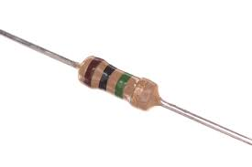

More about resistors
Resistor |  |  | 1 kilohm (kΩ) = 1000 Ω 1 megohm (MΩ) = 1 000 000 Ω

Slide 39
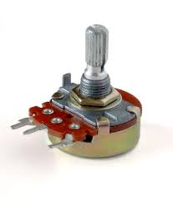
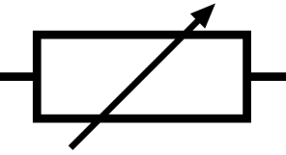
More about resistors
Resistor |  |  | 1 kilohm (kΩ) = 1000 Ω 1 megohm (MΩ) = 1 000 000 Ω
Variable resistor |  |  | Used for varying current, for example in light dimmer switches

Slide 40
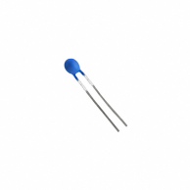
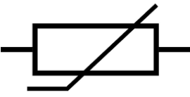
More about resistors
Resistor |  |  | 1 kilohm (kΩ) = 1000 Ω 1 megohm (MΩ) = 1 000 000 Ω
Variable resistor |  |  | Used for varying current, for example in light dimmer switches
Thermistor |  |  | High resistance when cold, but much lower resistance when hot. Eg. Digital thermometer

Slide 41
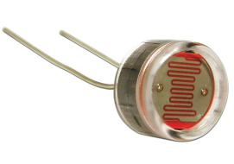
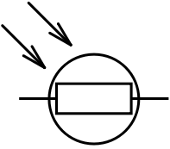
More about resistors
Resistor |  |  | 1 kilohm (kΩ) = 1000 Ω 1 megohm (MΩ) = 1 000 000 Ω
Variable resistor |  |  | Used for varying current, for example in light dimmer switches
Thermistor |  |  | High resistance when cold, but much lower resistance when hot. Eg. Digital thermometer
Light dependent resistor (LDR) |  |  | High resistance in the dark but a low resistance in the light. Eg. Controlling light switches

Slide 42
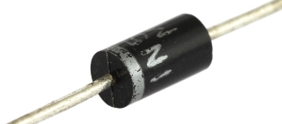
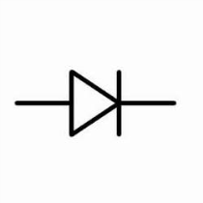
More about resistors
Resistor |  |  | 1 kilohm (kΩ) = 1000 Ω 1 megohm (MΩ) = 1 000 000 Ω
Variable resistor |  |  | Used for varying current, for example in light dimmer switches
Thermistor |  |  | High resistance when cold, but much lower resistance when hot. Eg. Digital thermometer
Light dependent resistor (LDR) |  |  | High resistance in the dark but a low resistance in the light. Eg. Controlling light switches
Diode |  |  | Extremely high resistance in one direction, but low in the other. Controls flow of current

Slide 43
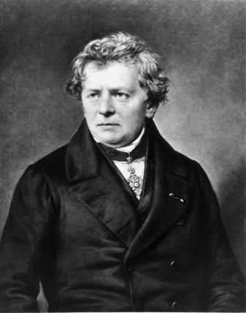
Ohm’s Law
A 19th Century scientist who first investigated the electrical properties of wires, and the relationship between V, I and R
I (the symbol for current) = “intensite du courant”

Slide 44

How current varies with voltage (PD) for a metal conductor.
Ohm’s Law
Circuit diagram:
battery
Variable resistor
Ammeter
Voltmeter
A
V
Water bath to keep nichrome at constant temperature
Nichrome wire

Slide 45
How current varies with voltage (PD) for a metal conductor.
Ohm’s Law
Circuit diagram:
battery
V | I | R = V/I
2.0V | 0.4A | 5.0Ω
4.0 | 0.8 | 5.0
6.0 | 1.2 | 5.0
8.0 | 1.6 | 5.0
10.0 | 2.0 | 5.0
Variable resistor
Ammeter
Voltmeter
A
V
Water bath to keep nichrome at constant temperature
Nichrome wire

Slide 46
How current varies with voltage (PD) for a metal conductor.
Ohm’s Law
Circuit diagram:
battery
V | I | R = V/I
2.0V | 0.4A | 5.0Ω
4.0 | 0.8 | 5.0
6.0 | 1.2 | 5.0
8.0 | 1.6 | 5.0
10.0 | 2.0 | 5.0
Variable resistor
Ammeter
Voltmeter
A
V
2.0
Current (A)
Water bath to keep nichrome at constant temperature
Nichrome wire
0
10.0
Voltage (V)

Slide 47
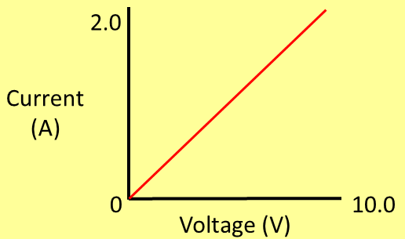
Ohm’s Law
A graph of current against voltage is a straight line through the origin.
If the voltage doubles then the current doubles, etc
In this experiment, V/I always has the same value.

Slide 48
Ohm’s Law
A graph of current against voltage is a straight line through the origin.
If the voltage doubles then the current doubles, etc
In this experiment, V/I always has the same value.
Current is proportional to the voltage.
Current Voltage

Slide 49
Ohm’s Law
Provided temperature is constant
A graph of current against voltage is a straight line through the origin.
If the voltage doubles then the current doubles, etc
In this experiment, V/I always has the same value.
Current is proportional to the voltage.
Current Voltage

Slide 50
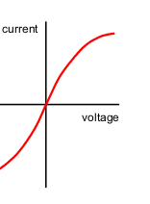
So what happens if temperature changes?
For a tungsten filament lamp, as the current increases, the temperature rises and the resistance increases. Current is not directly proportional to the voltage.

Slide 51
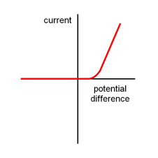
So what happens if temperature changes?
And for the diode …….
For a tungsten filament lamp, as the current increases, the temperature rises and the resistance increases. Current is not directly proportional to the voltage.
Current is not proportional to the voltage. If the voltage is reversed, the resistance increases greatly, so effectively making sure that current only flows in one direction in the circuit.

Slide 52

Understand that electric circuits transfer energy from the battery or power source to the circuit components then into the surroundings
And finally …

Slide 53
Understand that electric circuits transfer energy from the battery or power source to the circuit components then into the surroundings
And finally …
Chemical energy is transformed into potential energy in the electrons, and in the bulb this is changed into thermal (heat) energy.

Slide 54
Understand that electric circuits transfer energy from the battery or power source to the circuit components then into the surroundings
And finally …
Chemical energy is transformed into potential energy in the electrons, and in the bulb this is changed into thermal (heat) energy.
The rate at which energy is transformed is known as POWER. The unit of power is the watt (W).

Slide 55
Understand that electric circuits transfer energy from the battery or power source to the circuit components then into the surroundings
And finally …
Chemical energy is transformed into potential energy in the electrons, and in the bulb this is changed into thermal (heat) energy.
P = I x V
P
V = P / I
The rate at which energy is transformed is known as POWER. The unit of power is the watt (W).
I = P / V
I
V
1 kilowatt (kW) = 1000 watts

Slide 56

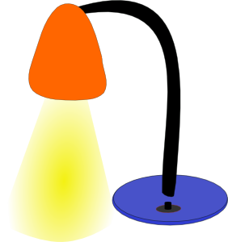


Understand that electric circuits transfer energy from the battery or power source to the circuit components then into the surroundings
And finally …
2200W (2.2kW)
450W
11W
80W

Slide 57
Supplement
And finally …
Recall and use the equations P = IV and E = IVt

Slide 58
Supplement
And finally …
Power = energy transformed
time taken
Recall and use the equations P = IV and E = IVt

Slide 59
Supplement
And finally …
Power = energy transformed
time taken
Recall and use the equations P = IV and E = IVt
P = E
t

Slide 60
Supplement
And finally …
Power = energy transformed
time taken
Recall and use the equations P = IV and E = IVt
P = E
t
E = P x t

Slide 61

Supplement
And finally …
Power = energy transformed
time taken
Recall and use the equations P = IV and E = IVt
P = E
t
E = I x V x t
E = P x t

Slide 62
Supplement
And finally …
Power = energy transformed
time taken
Recall and use the equations P = IV and E = IVt
P = E
t
E = I x V x t
E = P x t
Joules per second

Slide 63
LEARNING OBJECTIVES
Core •State that the e.m.f. of an electrical source of energy is measured in volts State that the potential difference (p.d.) across a circuit component is measured in volts Use and describe the use of a voltmeter, both analogue and digital State that resistance = p.d. / current and understand qualitatively how changes in p.d. or resistance affect current • Recall and use the equation R = V / I • Describe an experiment to determine resistance using a voltmeter and an ammeter Relate (without calculation) the resistance of a wire to its length and to its diameter Understand that electric circuits transfer energy from the battery or power source to the circuit components then into the surroundings | Supplement Show understanding that e.m.f. is defined in terms of energy supplied by a source in driving charge round a complete circuit Recall that 1 V is equivalent to 1 J / C Sketch and explain the current-voltage characteristic of an ohmic resistor and a filament lamp • Recall and use quantitatively the proportionality between resistance and length, and the inverse proportionality between resistance and cross-sectional area of a wire Recall and use the equations P = IV and E = IVt

Slide 64
PHYSICS – Electrical quantities (2)

