Slide 1
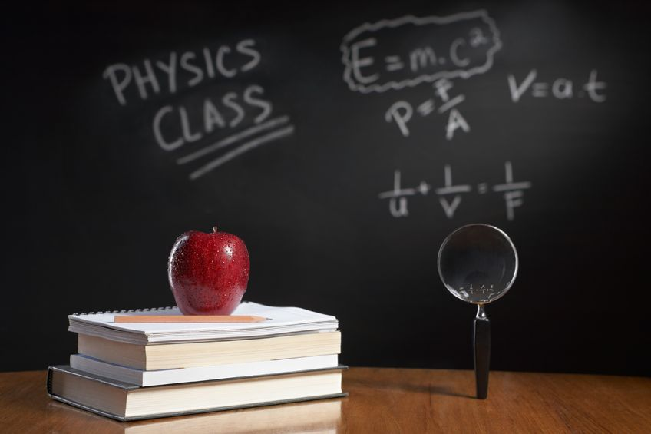
PHYSICS – Forces 3. Centre of mass.

Slide 2
LEARNING OBJECTIVES
1.5.4 Centre of mass Core • Perform and describe an experiment to determine the position of the centre of mass of a plane lamina • Describe qualitatively the effect of the position of the centre of mass on the stability of simple objects 1.5.5 Scalars and vectors | Supplement • Understand that vectors have a magnitude and direction • Demonstrate an understanding of the difference between scalars and vectors and give common examples • Determine graphically the resultant of two vectors

Slide 3
Centre of Mass
Upward force on ruler

Slide 4
Centre of Mass
Upward force on ruler
Suspension point (G)
Lots of tiny particles exerting gravitational forces on either side of point G

Slide 5
Centre of Mass
Upward force on ruler
Suspension point (G)
Lots of tiny particles exerting gravitational forces on either side of point G
When the gravitational forces on either side of G are equal, the ruler is balanced.

Slide 6
Centre of Mass
Upward force on ruler
Suspension point (G)
Lots of tiny particles exerting gravitational forces on either side of point G
When the gravitational forces on either side of G are equal, the ruler is balanced.
The forces now act together at G (a resultant force) = the weight.
G is the centre of mass, or centre of gravity.

Slide 7
LEARNING OBJECTIVES
1.5.4 Centre of mass Core • Perform and describe an experiment to determine the position of the centre of mass of a plane lamina • Describe qualitatively the effect of the position of the centre of mass on the stability of simple objects 1.5.5 Scalars and vectors | Supplement • Understand that vectors have a magnitude and direction • Demonstrate an understanding of the difference between scalars and vectors and give common examples • Determine graphically the resultant of two vectors

Slide 8
So how do you find the centre of mass (centre of gravity) for an irregularly shaped object?

Slide 9
So how do you find the centre of mass (centre of gravity) for an irregularly shaped object?

Slide 10
So how do you find the centre of mass (centre of gravity) for an irregularly shaped object?
Allow the card to swing freely from the pin.

Slide 11
So how do you find the centre of mass (centre of gravity) for an irregularly shaped object?
Allow the card to swing freely from the pin.
The card turns until the centre of mass is vertically under the pin.

Slide 12
So how do you find the centre of mass (centre of gravity) for an irregularly shaped object?
Allow the card to swing freely from the pin.
Repeat using a plumb line, and wherever the lines cross, this is the centre of mass.
The card turns until the centre of mass is vertically under the pin.

Slide 13
LEARNING OBJECTIVES
1.5.4 Centre of mass Core • Perform and describe an experiment to determine the position of the centre of mass of a plane lamina • Describe qualitatively the effect of the position of the centre of mass on the stability of simple objects 1.5.5 Scalars and vectors | Supplement • Understand that vectors have a magnitude and direction • Demonstrate an understanding of the difference between scalars and vectors and give common examples • Determine graphically the resultant of two vectors

Slide 14
Centre of Mass and Stability
If a force is applied, which box will be the most stable?

Slide 15
Centre of Mass and Stability
Centre of mass
Weight acting downwards
Upward force from ground
The box here is in equilibrium. Forces are balanced, as are the turning effects.

Slide 16
Centre of Mass and Stability
If a small force is applied, the tilt is small and the upward and downward forces will act to return the box to its original position.

Slide 17
Centre of Mass and Stability
With a larger force applied there is more tilt, the box goes beyond the centre of gravity, so will fall over.

Slide 18
Centre of Mass and Stability
If the box has a wider base and a lower centre of gravity then it will be harder to tip over.

Slide 19
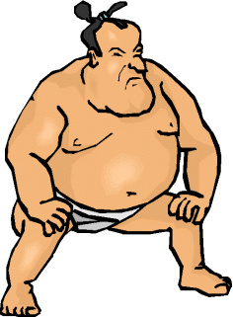
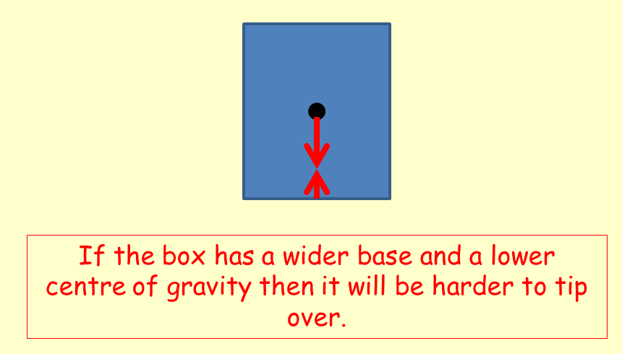
Centre of Mass and Stability

Slide 20
LEARNING OBJECTIVES
1.5.4 Centre of mass Core • Perform and describe an experiment to determine the position of the centre of mass of a plane lamina • Describe qualitatively the effect of the position of the centre of mass on the stability of simple objects 1.5.5 Scalars and vectors | Supplement • Understand that vectors have a magnitude and direction • Demonstrate an understanding of the difference between scalars and vectors and give common examples • Determine graphically the resultant of two vectors

Slide 21
Scalars and Vectors
Forces, which have both direction and size, are known as vectors.

Slide 22
Scalars and Vectors
Forces, which have both direction and size, are known as vectors.
The resultant force can be calculated by adding the vectors together.

Slide 23
Scalars and Vectors
Forces, which have both direction and size, are known as vectors.
The resultant force can be calculated by adding the vectors together.
40N
50N
90N

Slide 24
Scalars and Vectors
Forces, which have both direction and size, are known as vectors.
The resultant force can be calculated by adding the vectors together.
40N
50N
10N

Slide 25
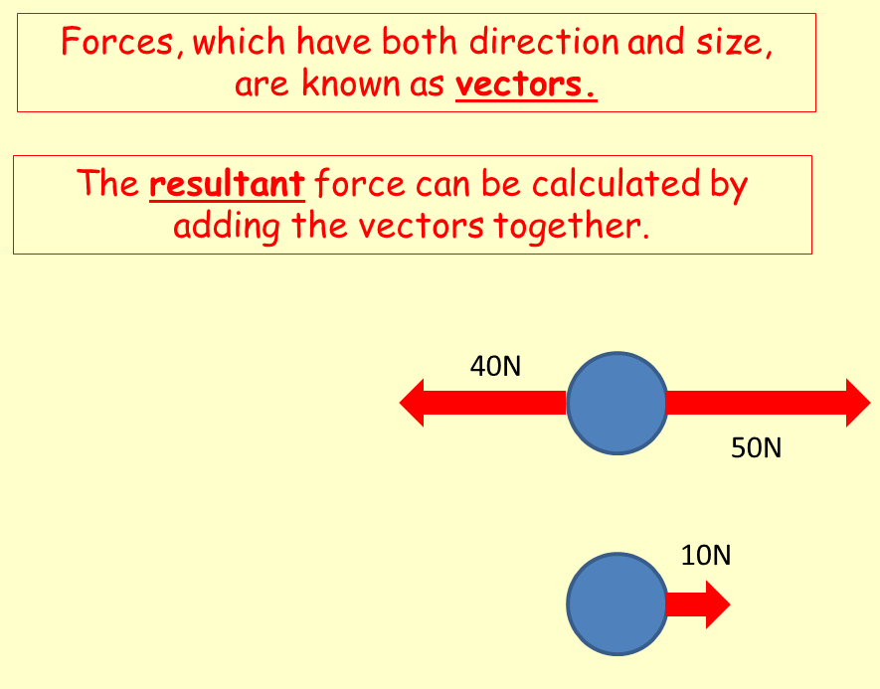
Scalars and Vectors
Quantities such as mass and volume, which have size but no direction, are known as scalars.
Scalars are simply added together.
Eg. A mass of 40kg added to a mass of 60kg will always give a mass of 100kg.

Slide 26
Scalars and Vectors
How do we work out the resultant when the forces are not acting along the same line?

Slide 27
Scalars and Vectors
How do we work out the resultant when the forces are not acting along the same line?
To find the resultant in this situation we apply the parallelogram rule.

Slide 28
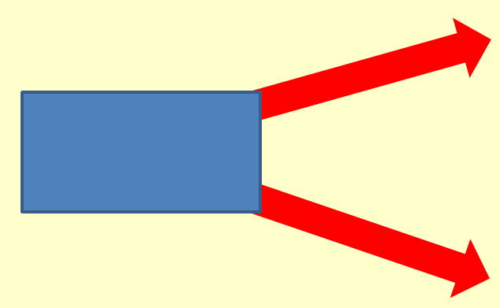
What’s all this about a parallelogram rule? I might need to sit down for this bit!
30N
40N
We need to draw the force lines accurately, both in terms of direction, and size. In this example, 1N = 1mm

Slide 29
What’s all this about a parallelogram rule? I might need to sit down for this bit!
30N
40N
We need to draw the force lines accurately, both in terms of direction, and size. In this example, 1N = 1mm

Slide 30
What’s all this about a parallelogram rule? I might need to sit down for this bit!
30N
X
60N
Y
40N
Draw two lines to complete the parallelogram, and then connect the diagonal from X to Y. The size and direction of the diagonal represents the resultant in both size and direction.

Slide 31
What’s all this about a parallelogram rule? I might need to sit down for this bit!
30N
X
60N
Y
40N
Draw two lines to complete the parallelogram, and then connect the diagonal from X to Y. The size and direction of the diagonal represents the resultant in both size and direction.

Slide 32
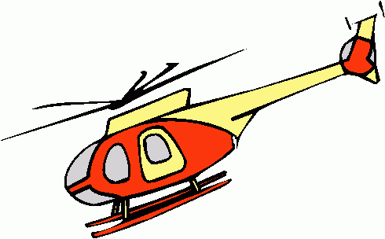
Components at right angles
Resultant lift from main rotor
Vertical component supports weight
Horizontal component moves helicopter forward
When a helicopter tilts its main rotor, the force has vertical and horizontal components which move it forward and lift it at the same time.

Slide 33
LEARNING OBJECTIVES
1.5.4 Centre of mass Core • Perform and describe an experiment to determine the position of the centre of mass of a plane lamina • Describe qualitatively the effect of the position of the centre of mass on the stability of simple objects 1.5.5 Scalars and vectors | Supplement • Understand that vectors have a magnitude and direction • Demonstrate an understanding of the difference between scalars and vectors and give common examples • Determine graphically the resultant of two vectors

Slide 34
PHYSICS – Forces 3

