Slide 1
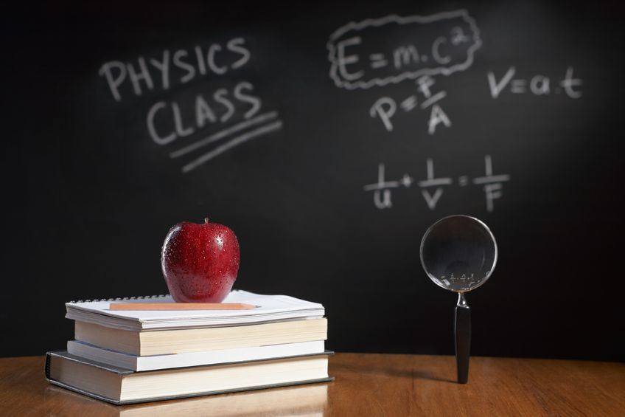
PHYSICS – The Electromagnetic Spectrum

Slide 2
LEARNING OBJECTIVES
Core •Give a qualitative account of the dispersion of light as shown by the action on light of a glass prism including the seven colours of the spectrum in their correct order Describe the main features of the electromagnetic spectrum in order of wavelength • State that all e.m. waves travel with the same high speed in a vacuum • Describe typical properties and uses of radiations in all the different regions of the electromagnetic spectrum including: – r adio and television communications (radio waves) – s atellite television and telephones (microwaves) – e lectrical appliances, remote controllers for televisions and intruder alarms (infra-red) – medicine and security (X-rays) • Demonstrate an awareness of safety issues regarding the use of microwaves and X-rays | Supplement Recall that light of a single frequency is described as monochromatic State that the speed of electromagnetic waves in a vacuum is 3.0 × 108 m / s and is approximately the same in air

Slide 3
Refraction of light by a prism.
White light

Slide 4
Refraction of light by a prism.
Refraction

Slide 5
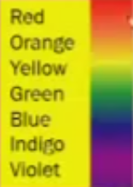
Refraction of light by a prism.

Slide 6
Refraction of light by a prism.
This effect is called dispersion

Slide 7
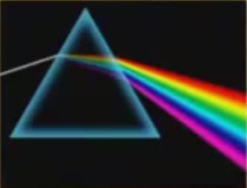
Refraction of light by a prism.
This effect is called dispersion

Slide 8
Refraction of light by a prism.
This effect is called dispersion
It happens because white is a mixture of all the colours in the rainbow

Slide 9
Wavelength and colour
White light is made up of different colours with wavelengths ranging from 0.0004mm (violet) to 0.0007mm (red).

Slide 10
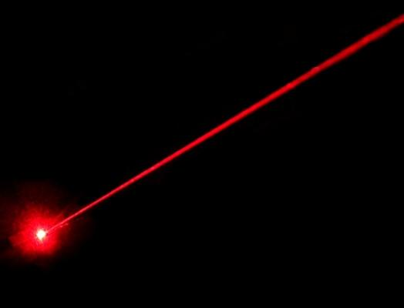
Wavelength and colour
White light is made up of different colours with wavelengths ranging from 0.0004mm (violet) to 0.0007mm (red).
Lasers, however, only emit light of a single colour and wavelength.
This type of light is known as monochromatic light.

Slide 11
LEARNING OBJECTIVES
Core •Give a qualitative account of the dispersion of light as shown by the action on light of a glass prism including the seven colours of the spectrum in their correct order Describe the main features of the electromagnetic spectrum in order of wavelength • State that all e.m. waves travel with the same high speed in a vacuum • Describe typical properties and uses of radiations in all the different regions of the electromagnetic spectrum including: – r adio and television communications (radio waves) – s atellite television and telephones (microwaves) – e lectrical appliances, remote controllers for televisions and intruder alarms (infra-red) – medicine and security (X-rays) • Demonstrate an awareness of safety issues regarding the use of microwaves and X-rays | Supplement Recall that light of a single frequency is described as monochromatic State that the speed of electromagnetic waves in a vacuum is 3.0 × 108 m / s and is approximately the same in air

Slide 12
The Electromagnetic Spectrum

Slide 13
The Electromagnetic Spectrum

Slide 14
The Electromagnetic Spectrum
Features of the electromagnetic spectrum
1. They can travel through a vacuum (eg. Space)

Slide 15
The Electromagnetic Spectrum
Features of the electromagnetic spectrum
They can travel through a vacuum (eg. Space)
In a vacuum they travel at a speed of 300 000 kilometres per second.

Slide 16
The Electromagnetic Spectrum
Features of the electromagnetic spectrum
They can travel through a vacuum (eg. Space)
In a vacuum they travel at a speed of 300 000 kilometres per second.
They are all transverse waves, with oscillations at right angles to the direction of travel.

Slide 17
The Electromagnetic Spectrum
Features of the electromagnetic spectrum
They can travel through a vacuum (eg. Space)
In a vacuum they travel at a speed of 300 000 kilometres per second.
They are all transverse waves, with oscillations at right angles to the direction of travel.
Electromagnetic waves transfer energy.

Slide 18
The Electromagnetic Spectrum
Wavelength
(m)
10⁴
10⁻¹
10⁻³
10⁻⁶
10⁻⁷
10⁻⁹
10⁻¹¹
10⁻¹⁴

Slide 19
The Electromagnetic Spectrum
Frequency
(Hz)
10⁵
10¹⁰
10¹²
10¹⁴
10¹⁵
10¹⁷
10¹⁹
10²²

Slide 20
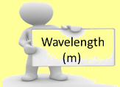
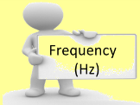
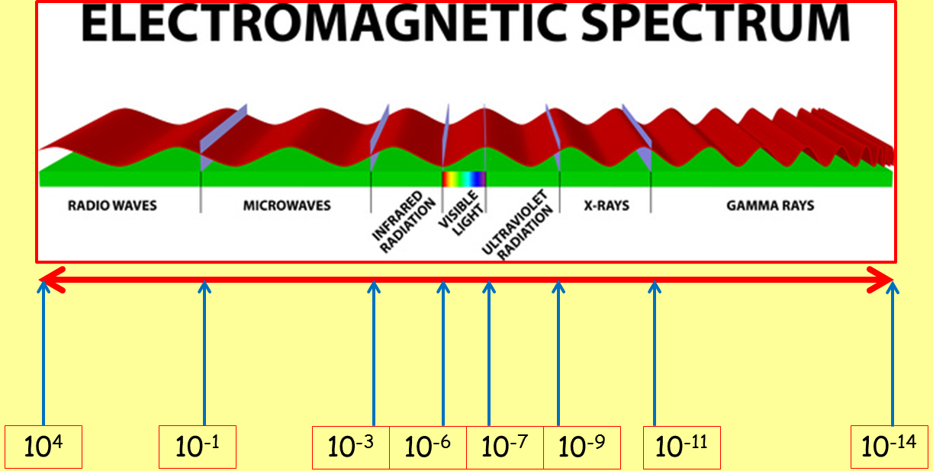
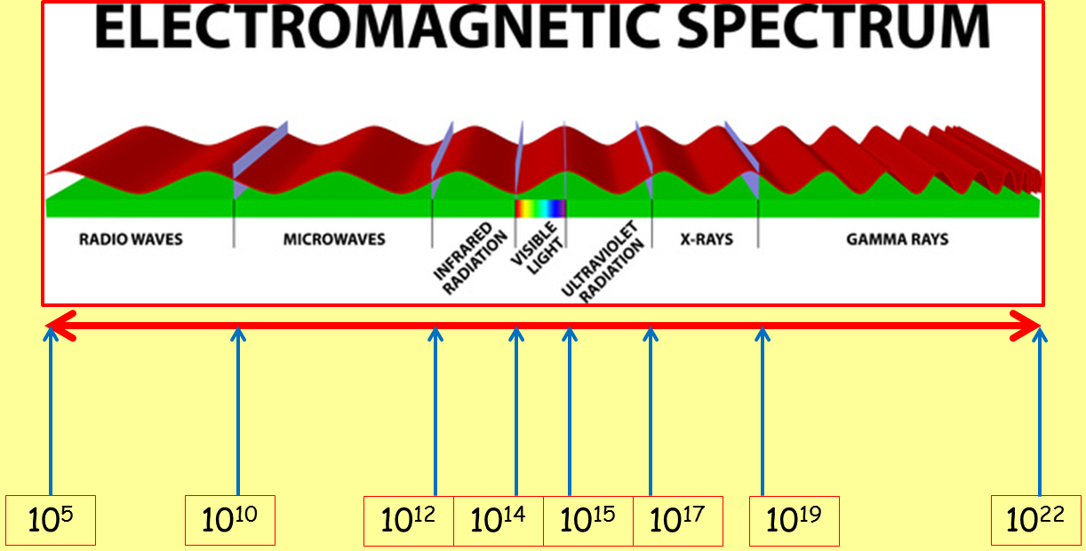
Wavelengths decrease going along the EM spectrum from radio waves to gamma rays.
Frequencies increase going along the EM spectrum from radio waves to gamma rays.

Slide 21
Wavelengths decrease going along the EM spectrum from radio waves to gamma rays.
Frequencies increase going along the EM spectrum from radio waves to gamma rays.
Radio wave photons have the lowest frequency and the least energy, and gamma ray photons have the highest frequency and the most energy.

Slide 22
The Electromagnetic Spectrum
Intensity and distance
Whenever radiation is absorbed by matter, photons transfer their energy to the matter.

Slide 23
The Electromagnetic Spectrum
Intensity and distance
Whenever radiation is absorbed by matter, photons transfer their energy to the matter.
The energy deposited by a beam of electrons depends upon the number of photons and the energy of each photon.

Slide 24
The Electromagnetic Spectrum
Intensity and distance
Whenever radiation is absorbed by matter, photons transfer their energy to the matter.
The energy deposited by a beam of electrons depends upon the number of photons and the energy of each photon.
The intensity of radiation means how much energy arrives at each square metre of surface per second (W/m²).

Slide 25
The Electromagnetic Spectrum
Intensity and distance
Whenever radiation is absorbed by matter, photons transfer their energy to the matter.
The energy deposited by a beam of electrons depends upon the number of photons and the energy of each photon.
The intensity of radiation means how much energy arrives at each square metre of surface per second (W/m²).
The intensity of a beam of radiation decreases with distance from the source.

Slide 26
The beam gets spread out
The beam gets partially absorbed as it travels.
The Electromagnetic Spectrum
Intensity and distance
Whenever radiation is absorbed by matter, photons transfer their energy to the matter.
The energy deposited by a beam of electrons depends upon the number of photons and the energy of each photon.
The intensity of radiation means how much energy arrives at each square metre of surface per second (W/m²).
The intensity of a beam of radiation decreases with distance from the source.

Slide 27
The Electromagnetic Spectrum
…. and ionisation

Slide 28
The Electromagnetic Spectrum
…. and ionisation
Some high energy EM radiation (ultraviolet, X-rays and gamma rays) are known as ionising radiation because they have enough energy to remove an electron from an atom or molecule)

Slide 29
The Electromagnetic Spectrum
…. and ionisation
Some high energy EM radiation (ultraviolet, X-rays and gamma rays) are known as ionising radiation because they have enough energy to remove an electron from an atom or molecule)
Before ionisation
photon
Atom or molecule

Slide 30
The Electromagnetic Spectrum
…. and ionisation
Some high energy EM radiation (ultraviolet, X-rays and gamma rays) are known as ionising radiation because they have enough energy to remove an electron from an atom or molecule)
Before ionisation
After ionisation
photon
electron
Atom or molecule
Changed atom or molecule
The photon hits the atom or molecule, and removes an electron.

Slide 31
The Electromagnetic Spectrum
…. and ionisation
Some high energy EM radiation (ultraviolet, X-rays and gamma rays) are known as ionising radiation because they have enough energy to remove an electron from an atom or molecule)
Before ionisation
After ionisation
If cells are exposed to ionising radiation, they can damage the DNA in the nucleus of the cell. This can cause mutations, and the cells divide constantly without control – this is cancer.
Very high doses of ionising radiation can kill cells.
Excessive exposure to UV radiation can lead to sunburn or even skin cancer.
Increased exposure = more damage
photon
electron
Atom or molecule
Changed atom or molecule
The photon hits the atom or molecule, and removes an electron.

Slide 32
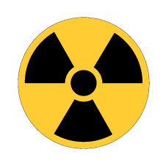
The Electromagnetic Spectrum
…. and dangers

Slide 33
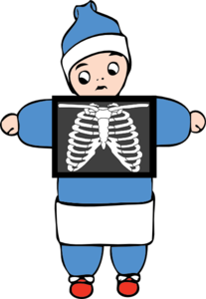
The Electromagnetic Spectrum
…. and dangers
X - rays
X-rays are used by radiographers in hospitals to check for broken bones.
X-rays pass easily through flesh, but are absorbed by denser materials like bone and metal.
X-ray imaging is also used in airports to check the contents of bags.
Precautions: radiograhers wear lead aprons or stand behind concrete to protect themselves.

Slide 34
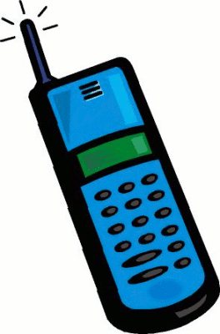
The Electromagnetic Spectrum
…. and dangers
X - rays
Microwaves
X-rays are used by radiographers in hospitals to check for broken bones.
X-rays pass easily through flesh, but are absorbed by denser materials like bone and metal.
X-ray imaging is also used in airports to check the contents of bags.
Precautions: radiograhers wear lead aprons or stand behind concrete to protect themselves.
Microwaves are used to send signals between mobile phones and mobile phone masts.
When you make calls on your mobile, your phone emits microwave radiation. Some of this is absorbed by your body and may cause heating of body tissues.
This heating could result in medical conditions, possibly including cancer, but there is no conclusive evidence.
Precaution: limit the amount of time you spend talking on a mobile phone!

Slide 35
The Electromagnetic Spectrum
Uses

Slide 36
The Electromagnetic Spectrum
Uses
Broadcasting
Communications,
Satellite transmissions

Slide 37
The Electromagnetic Spectrum
Uses
Broadcasting
Communications,
Satellite transmissions
Cooking,
Communications,
Satellite transmissions

Slide 38
The Electromagnetic Spectrum
Uses
Broadcasting
Communications,
Satellite transmissions
Cooking,
Communications,
Satellite transmissions
Cooking, thermal imaging, short range communications, optical fibres, TV remote controls, security systems.

Slide 39
The Electromagnetic Spectrum
Uses
Broadcasting
Communications,
Satellite transmissions
Cooking,
Communications,
Satellite transmissions
Vision
Photography
Illumination
Cooking, thermal imaging, short range communications, optical fibres, TV remote controls, security systems.

Slide 40
The Electromagnetic Spectrum
Uses
Vision
Photography
Illumination
Broadcasting
Communications,
Satellite transmissions
Cooking,
Communications,
Satellite transmissions
Cooking, thermal imaging, short range communications, optical fibres, TV remote controls, security systems.
Security marking,
Fluorescent lamps,
Detecting forged bank notes,
Disinfecting water

Slide 41
The Electromagnetic Spectrum
Uses
Vision
Photography
Illumination
Security marking,
Fluorescent lamps,
Detecting forged bank notes,
Disinfecting water
Broadcasting
Communications,
Satellite transmissions
Cooking,
Communications,
Satellite transmissions
Cooking, thermal imaging, short range communications, optical fibres, TV remote controls, security systems.
Observing the internal structure of objects,
Airport security scanners,
Medical X-rays

Slide 42
The Electromagnetic Spectrum
Uses
Vision
Photography
Illumination
Security marking,
Fluorescent lamps,
Detecting forged bank notes,
Disinfecting water
Broadcasting
Communications,
Satellite transmissions
Cooking,
Communications,
Satellite transmissions
Cooking, thermal imaging, short range communications, optical fibres, TV remote controls, security systems.
Observing the internal structure of objects,
Airport security scanners,
Medical X-rays
Sterilising food and medical equipment,
Detection of cancer and its treatment.

Slide 43
LEARNING OBJECTIVES
Core •Give a qualitative account of the dispersion of light as shown by the action on light of a glass prism including the seven colours of the spectrum in their correct order Describe the main features of the electromagnetic spectrum in order of wavelength • State that all e.m. waves travel with the same high speed in a vacuum • Describe typical properties and uses of radiations in all the different regions of the electromagnetic spectrum including: – r adio and television communications (radio waves) – s atellite television and telephones (microwaves) – e lectrical appliances, remote controllers for televisions and intruder alarms (infra-red) – medicine and security (X-rays) • Demonstrate an awareness of safety issues regarding the use of microwaves and X-rays | Supplement Recall that light of a single frequency is described as monochromatic State that the speed of electromagnetic waves in a vacuum is 3.0 × 108 m / s and is approximately the same in air

Slide 44
PHYSICS – The Electromagnetic Spectrum

